Slide 1
Language Modeling
Introduction to N-grams
Notes:
Generally speaking, a model (in the statistical sense of course) is a mathematical representation of a process.
Almost always models are an approximation of the process.
A statistician guy once said: All models are wrong, but some are useful.
What it does?: it describes how the modelled process (human language) creates data.

Slide 2
Probabilistic Language Models
Today’s goal: assign a probability to a sentence
Machine Translation:
P(high winds tonight) > P(large winds tonight)
Spell Correction
The office is about fifteen minuets from my house
P(about fifteen minutes from) > P(about fifteen minuets from)
Speech Recognition
P(I saw a van) >> P(eyes awe of an)
+ Summarization, question-answering, etc., etc.!!
Why?
Notes:
minuets: a slow, stately ballroom dance for two in triple time, popular especially in the 18th century.

Slide 3
Probabilistic Language Modeling
Goal: compute the probability of a sentence or sequence of words:
P(W) = P(w₁,w₂,w₃,w₄,w₅…w_{n})
Related task: probability of an upcoming word:
P(w₅|w₁,w₂,w₃,w₄)
A model that computes either of these:
P(W) or P(w_{n}|w₁,w₂…w_{n-1}) is called a language model.
Better: the grammar But language model or LM is standard

Slide 4
How to compute P(W)
How to compute this joint probability:
P(its, water, is, so, transparent, that)
Intuition: let’s rely on the Chain Rule of Probability

Slide 5
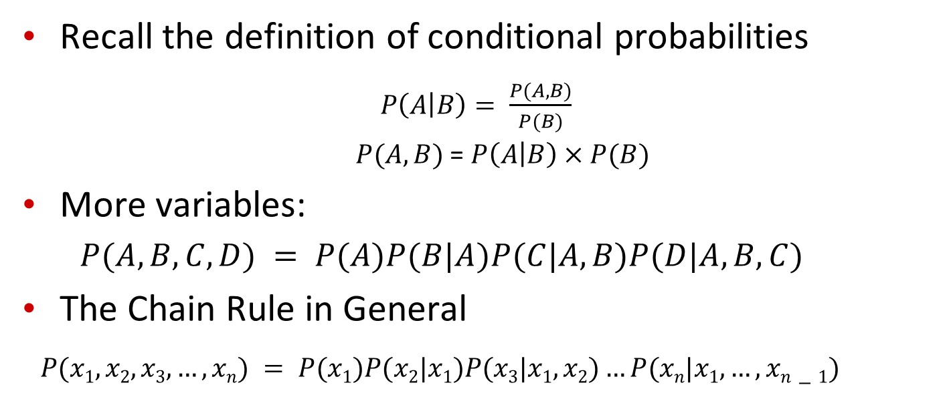
Reminder: The Chain Rule
Recall the definition of conditional probabilities
$P\left(A | B\right)= \frac{P(A,B)}{P(B)}$
$P(A,B)$ = $P\left(A | B\right)×P(B)$
More variables:
$P(A,B,C,D) = P(A)P(B|A)P(C|A,B)P(D|A,B,C)$
The Chain Rule in General
$P(x1,x2,x3,…,xn) = P(x1)P(x2|x1)P(x3|x1,x2)…P(xn|x1,…,xn−1)$

Slide 6
The Chain Rule applied to compute joint probability of words in sentence
P(“its water is so transparent”) =
P(its) × P(water|its) × P(is|its water)
× P(so|its water is) × P(transparent|its water is so)

Slide 7
How to estimate these probabilities
Could we just count and divide?
No! Too many possible sentences!
We’ll never see enough data for estimating these

Slide 8
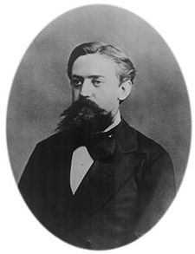
Markov Assumption
Simplifying assumption:
Or maybe
Andrei Markov

Slide 9
Markov Assumption
In other words, we approximate each component in the product

Slide 10
Simplest case: Unigram model
Some automatically generated sentences from a unigram model
fifth, an, of, futures, the, an, incorporated, a, a, the, inflation, most, dollars, quarter, in, is, mass
thrift, did, eighty, said, hard, 'm, july, bullish
that, or, limited, the
Notes:
Bag of words

Slide 11
Bigram model
Condition on the previous word:
texaco, rose, one, in, this, issue, is, pursuing, growth, in, a, boiler, house, said, mr., gurria, mexico, 's, motion, control, proposal, without, permission, from, five, hundred, fifty, five, yen
outside, new, car, parking, lot, of, the, agreement, reached
this, would, be, a, record, november

Slide 12
N-gram models
We can extend to trigrams, 4-grams, 5-grams
In general this is an insufficient model of language
because language has long-distance dependencies:
“The computer which I had just put into the machine room on the fifth floor crashed.”
But we can often get away with N-gram models
Notes:
Try to predict crashed
It depends on computer

